Slide 1

2024-2025 Fiscal Year Budget
Manson School District No. 19

Slide 2
What are the budgets for Manson School District?
The District has five separate funds that must be budgeted for:
The General Fund contains all financial resources except for those required by Law to be accounted for in other funds. Revenues are primarily from state funds, special maintenance and operations levy funds, federal funds, and local fees. Expenditures include salaries and benefits costs, and non-labor costs such as supplies and instructional materials, utilities, fuel, insurance, and printing costs.
The Capital Projects Fund provides for acquisition of land/buildings and, major upgrades of facilities, and construction of new facilities. This fund is generally financed from the sale of bonds, transfers from the General Fund, and special capital levies.
The Debt Service Fund provides for the redemption and payment of interest on bonds. This fund is typically kept at a very low balance, except when a debt payment comes due.
The Associated Student Body (ASB) Fund accounts for the student extracurricular activities in each school. Revenues are generated, in part, by fees from students and nonstudents attending any optional noncredit extracurricular event of the district. Although the ASB fund is under the control of the Board of Directors, the ASB prepares and submits a revenue and expenditure plan for Board approval.
The Transportation Vehicle Fund accounts for the purchase of or major repair of pupil transportation equipment/buses. The Transportation Vehicle Fund is financed by state reimbursement to school districts for depreciation of approved pupil transportation equipment/buses.

Slide 7
What about the Scholarship Funds?
Manson School District has a Trust & Agency Fund that is made up of our separate scholarship funds:
Freer
Leffler
Beresford
Lopez
Lake Chelan Pickleball Fund
These funds are held in trust and are not considered property of the District. Because of this, we are not required to adopt a budget for this fund.

Slide 8
General Fund Overview
Fiscal Year 2024-2025

Slide 10
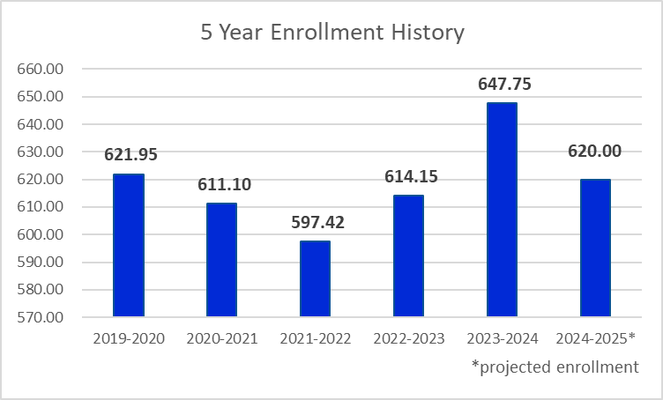
How is our enrollment?
In Washington State, enrollment drives the amount of state-provided funding school districts receive. We budgeted conservatively with 620 FTE for the 2024-2025 year, however we ended the school year with an FTE of 647.75.

Slide 11
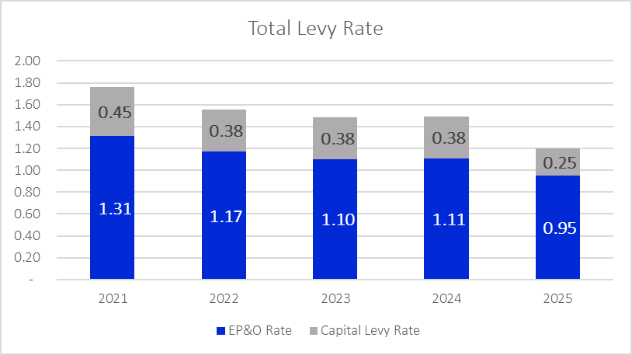
What is the status of our levies?
The District currently has two levies in effect.
Our Educational Programs and Operations (EPO) Levy was approved by voters on February 14, 2023 to continue to fund education programs and operations not funded by the State. The following collections were approved:
2024 – $1,884,500
2025 – $1,955,326
Our Capital Projects Levy was approved by voters on February 12, 2019 to build a new Early Learning Center, renovate existing facilities, and fund technology. The following collections were approved:
2020 – $499,000
2021 – $499,000
2022 – $499,000
2023 – $499,000
2024 – $499,000
2025 – $499,000

Slide 12
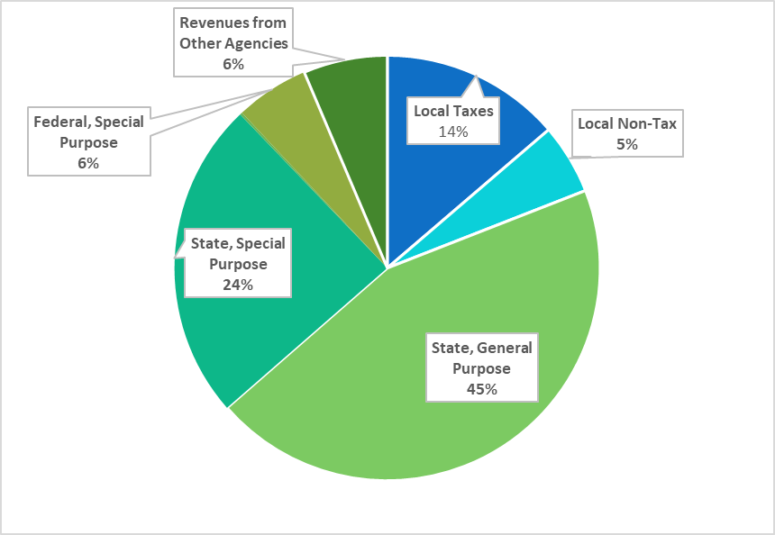
Where does the money come from?
60%, or $9,879,951, comes from the State, which consists of apportionment revenues based on actual enrollment and categorical programs.
6%, or $828,576, comes from Federal grants and funding, such as the Every Child Succeeds Act (ECSA).
14%, or $1,970,350, comes from Local taxes collected via our approved EPO levy. Because the District's fiscal year runs September 1st to August 31st, portions of two calendar years are used when determining the annual collection.
6%, or $917,287, comes from Education Service District 112 as part of our SPED coop.
5%, or $767,585, comes from Local non-tax revenues which include tuition, fees, food service revenues, interest revenues, and facility use fees. This is also where the District budgets capacity for new programs.

Slide 14
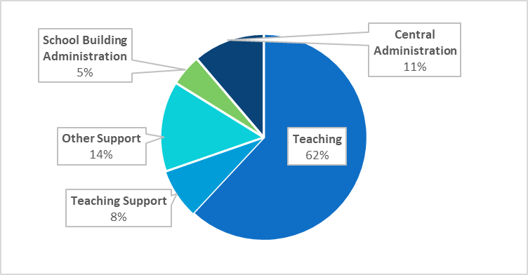
Where does the money go?
70%, or $9,805,176, is spent on teaching and teaching support. This includes funding for teachers, instructional assistants, teaching supplies, materials and textbooks, counselors and librarians, special education and related services, health services, and pupil management and safety.
14%, or $1,992,004, is spent on other school support. This includes operation and maintenance of buildings and grounds, utilities, security, student transportation, nutritional services, insurance, and data processing.
5%, or $695,305, is spent on school building management. This includes principals, assistant principals, secretarial and clerical support, and other expenses related to the management of the school building.
11%, or $1,579,595, is spent on central administration. This includes the expenses of the School Board, Superintendent’s Office, Human Resources, Business Office, and the some supervision activities.

Slide 17
What else do I need to know?
In 2020-2021, the State of Washington Supplemental Budget placed a new requirement on district reporting regarding the use of Materials, Supplies, and Other Contracts (MSOC) funds. This requirement states that as part of the budget development, hearing, and review process required by chapter 28A.505 RCW, each school district must disclose:
The amount of state funding to be received by the District;
The amount the district proposes to spend for materials, supplies, and operating costs;
If (a) exceeds (b): any proposed use of this difference, and how this use will improve student achievement.
Manson School District will receive, inclusive of CTE funding, $1,494,596 in state MSOC funding. We expect to spend $3,934,825 in MSOC, exceeding our state provided funding by $2,440,229.

Slide 18
Four Year Budget Projections
F-195F

Slide 26
Questions?

